Slide 1
Microservices
Why Microservices?
What are Microservices?
Monolithic v/s Microservices

Slide 2
Why Microservices?
The most common approach to develop this application is to implement all these functionalities in a single application.
This type of architecture where all the functionalities are implemented in one single application is called as Monolithic Architecture.
Some common layers in this architecture are as follows:
Presentation Layer — It responsible for handling HTTP requests and sending respose.
Service Layer — In this layer business logic of the application is implemented.
Persistence layer — In this layer logic for accessing the database is implemented.

Slide 3
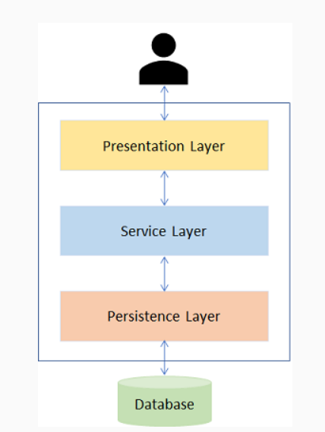
common layers in this architecture
Deployment will take a long time.
Scalability is an issue as it is not possible to scale any single functionality alone. For example, the 'Search' functionality maybe used more often than the 'Book' functionality. Hence, we would like to scale the 'Search' functionality and not the 'Book' functionality. This is not possible when we go with the monolithic approach.
Failure of a single functionality will lead to failure of entire application in monolithic architecture.
New technologies or frameworks cannot be used in the existing application. If new technology is needed, then complete re-write must be done.
It is not very reliable as a single bug in any module can bring down the entire application.
The applications developed using this architecture are easy to develop, test and deploy. However, there are certain issues that tag along with monolithic applications. As the application becomes larger and complex, we will face difficulties in the following aspects:

Slide 4
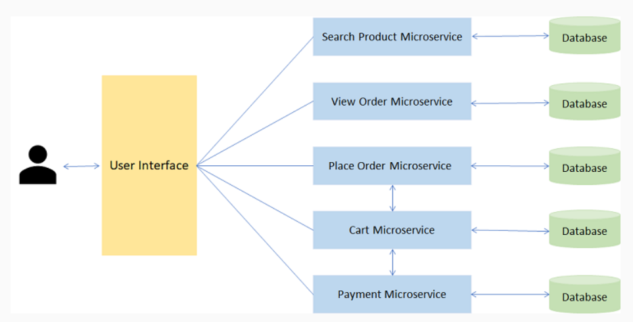
What are Microservices
Monolithic architecure all the fuctionalities are implemented in one single application and then this application is deployed. But it has some drawbacks which can be addressed if we develop the application using another architecure called as microservices.
In this architecture we split the application into a set of smaller services instead of building a single monolithic application.
Search Product Microservice - Responsible for seaching a product.
View Order Microservice - View orders placed by customer.
Place Order Microservice - Takes an order and process it.
Cart Microservice - Manage user cart, this service can utilize Catalog service as a data source.
Payment Microservice - Manage payments.

Slide 5
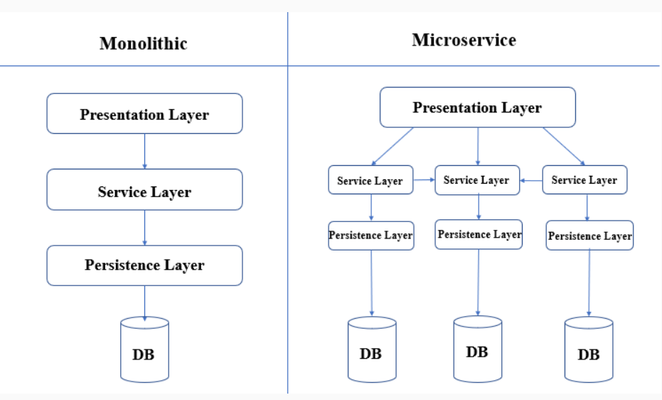
Monolithic v/s Microservices
Now let us see how functionally wise they are different.

Slide 6
Monolithic v/s Microservices: Development, Testing, Runtime, Packaging, Scalability, Minor Changes
Needs to be developed in a single language.
For any change, the entire application needs to be tested again.
Monolithic application runs as a single process.
Packaged as a single JAR/WAR file.
Entire application needs to be scaled or replicated on multiple servers.
For any modification. entire application needs to be re-built and re-deployed
Each service can be written in different languages.
Only the modified service needs to be tested again.
Each service runs its own process.
Each service is packaged as single JAR/WAR file.
Only the service that requires scaling, can be scaled.
Only the modified service needs to be re-built and re-deployed

Slide 7
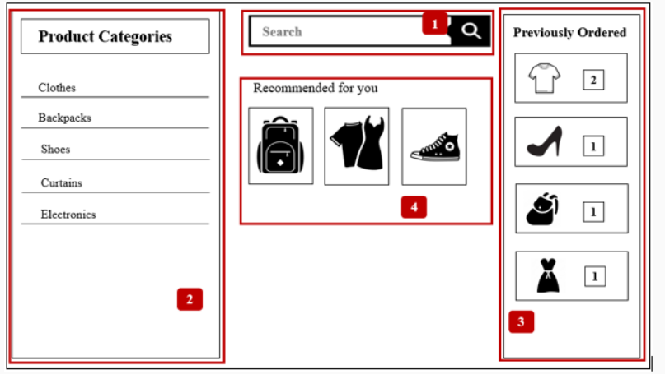
Simple MicroService example
An online shopping application can be divided into a number of microservices based on the functionality and business requirements.
Product Microservice: This microservice can be used to help the User search for any specific product that they are looking for.
Product Categories Microservice: This microservice shows all product categories available to the User.
Orders Microservice: This Microservice is responsible for placing orders and the User can view the order history as well.
Recommended Products Microservice: This microservice shows a list of recommended products to the User based on purchase history.

Slide 8
Reasons for choosing Microservice
Easy deployment
Small teams
Loose coupling
Domain-driven design

Slide 9
Microservice Usage Scenarios
Multiple reasons for choosing Microservice architecture.
Migrating a monolithic application due to improvements required in scalability, manageability and agility.
Rewriting a heavily used legacy application. (A legacy application is a software program that is outdated or obsolete.)
Highly agile applications due to domain-driven design of microservices.
Applications that demand speed of delivery as microservices are easy to build and maintain.
New product development where a new product is conceived and brought to market.

Slide 10
when should we choose Microservices and when should we choose Monolithic applications
We should choose Monolithic when
We should choose Microservices when
We have little knowledge of the market
The application we are developing is small
We have more knowledge of the market
The application being developed is a large enterprise application and needs to be highly scalable.

Slide 11
Advantages and Disadvantages of Microservices
Advantages
Disadvantages
Scalability
Fault Isolation
Speed of deployment
Freedom of technology
Autonomous teams
Performance
Maintenance
Infrastructure
Cost

Slide 12
Spring Cloud

Slide 14
Spring Cloud Consul

Slide 15
Setting up Consul
Download consul from software requirements given.
https://www.consul.io/downloads
Extract the downloaded zip file which contains a consul .exe file in it.
Open the command prompt window from the folder and start the consul server using the command as below:
-server: it is acting as consul server
-bootstrap-expect=1: expecting only one server instance. No cluster.
-data-dir: creates a folder with this name, where the consul data must be stored.
bind=192.168.100.13: ipv4 address of the machine where the consul server is running
Login to localhost:8500/ui the port where consul will run by default
Notes:
consul agent -server -bootstrap-expect=1 -data-dir=consul-data2 -ui -bind=192.168.100.13

Slide 16
Consul - Distributed configuration with Consul
Consul provides a Key/Value store for storing the configuration details.
During the bootstrap phase, the configuration data is loaded into the Spring environment.
By default, the Consul server refers to the /config folder for configuration data.
Create a /config folder in the Key/value store of the consul server
Create a file as an application/data inside the config folder. Ending a key with / means it is a folder, so this creates a folder as an application and it contains a file as data.
Place the common configuration data among all the microservices in the data file and choose the format as YAML.
Consul supports the config data in YAML/JSON/HCL format.
HCL (Hashicorp Consul configuration Language) is the Consul’s own configuration language with the syntax as key = value.

Slide 17
Create separate properties file for each microservice with the name of the file matching the spring.application.name of the service inside /config folder.
Place the respective properties in their respective files.
Add the Consul dependency in the pom.xml file of all the microservices
<dependency>
<groupId>org.springframework.cloud</groupId>
<artifactId>spring-cloud-starter-consul-config</artifactId>
</dependency>

Slide 18
In the bootstrap.yml file of all microservices, provide the Consul server details.
server:
port: 9400
spring:
application:
name: PlanMS
cloud:
consul:
host: localhost
config:
fail-fast: false
enabled: true
prefix: config
defaultContext: application
data-key: data
profileSeparator: '::'
format: YAML
enabled: setting this value to "false" disables Consul Config
prefix: sets the base folder for configuration values
defaultContext: sets the folder name used by all applications
profileSeparator: sets the value of the separator used to separate the profile name in property sources with profiles
format: format in which the configuration data is stored in consul, YAML/JSON/HCL format.

Slide 19
Consul - Distributed configuration with Consul
The Consul server will share the config data to the service during the bootstrap time but if there are any changes in the Consul config data, then we want it to be reflected in our microservices.
The consul server will automatically update the service with the config data changes once every 1000ms.
We can use the below property in the config file to customize this.
spring.cloud.consul.config.watch.delay: 100
Here, for every 100ms, the service will be notified with the updated config data from the Consul.

